Slide 1
Earthquake damage prediction Data Mining
2021-2022
FIB - UPC
Notes:
Intro - Andreu
Our Data - Andreu
preprocessing - Alex
evaluation criteria - Guille
Models:
Naive Bayes - Raúl
KNN - Lluc
Decision Trees - Guille
SVM Polinomical - Andreu
SVM Linear - Raúl
SVM RBF - Raúl
Metamethods - Joan
Conclusion - Joan & Lluc

Slide 2

Our Data
Classes:
1 - Represents a low damage level
2 - Represents a medium amount of damage
3 - Represents a high level of damage (almost complete destruction of the building)
Matrix:
39 columns
260.000 rows
Variables
8 numerical
22 binary
8 categorical

Slide 3
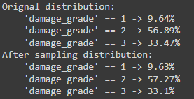
Pre-processing - Introduction
Non-specific
Train / Test datasets
Sample without replacement 20000 rows randomly
Feature selection will be done using 3 methods jointly

Slide 4
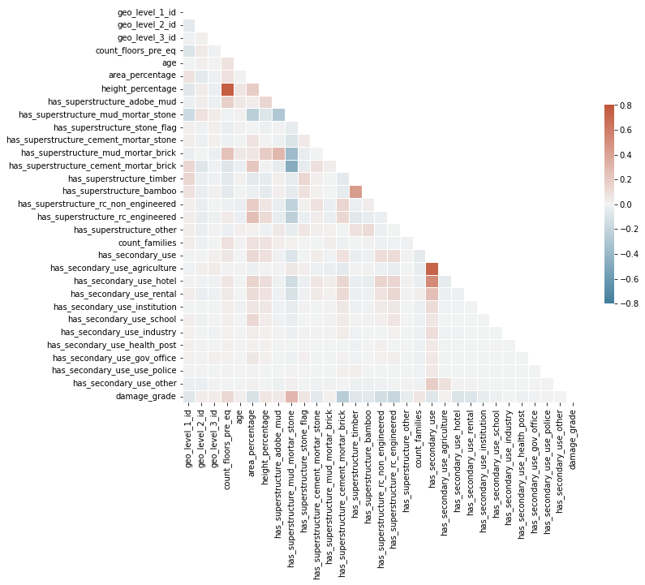

Pre-processing - Feature selection (By correlation)

Slide 5
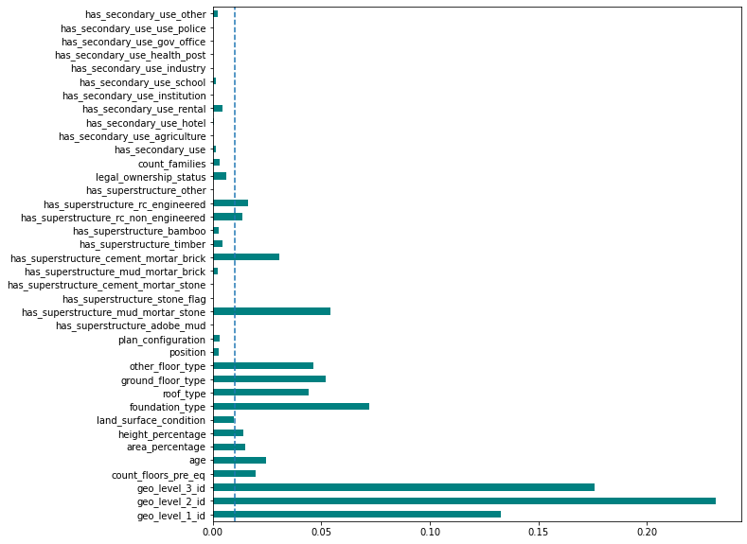
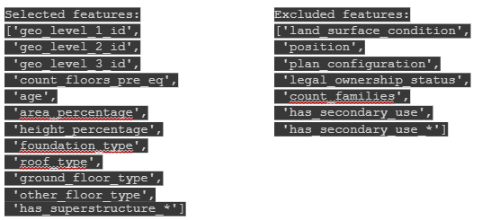
Pre-processing - Feature selection (By Information Gain)
Encode with LabelEncoder from sklearn.
0.01 threshold.

Slide 6
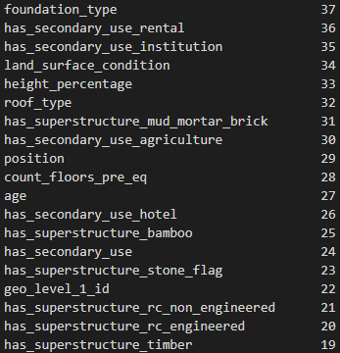
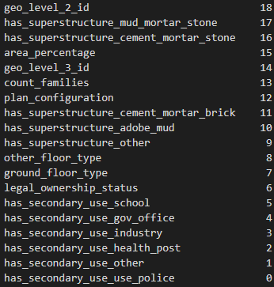
Pre-processing - Feature selection (By Fisher score)
Rank by Fisher score

Slide 7
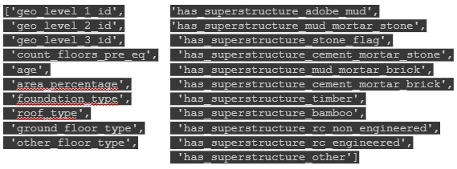
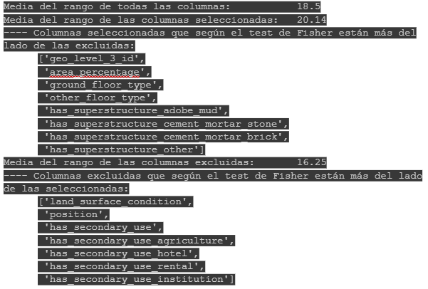
Pre-processing - Features selected / dropped
Method:
Main decision → Information Gain
Discard → Correlation
Validate → Fisher score ranking

Slide 8

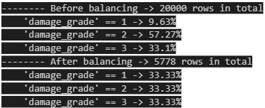
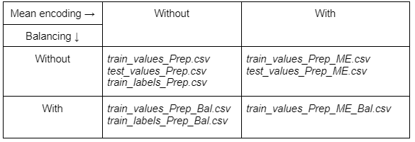
Pre-processing - Data treatment
One Hot Encoding: 17 → 25 columns.
Variance Threshold: 0 features eliminated.
Mean encoding geographical features.
Target variable is categorical, but also ordinal.
Test dataset presents problems (NaN values)
We assign the mean of the superior geographical location.
Balancing: we’ll undersample.
Save the data:

Slide 9
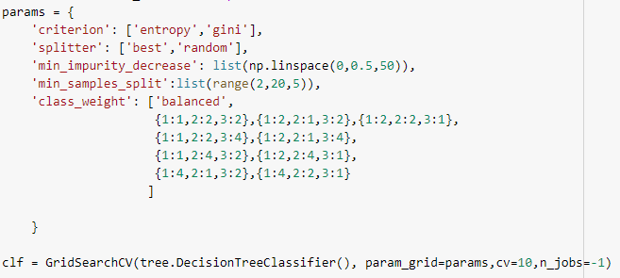
Evaluation Criteria

Slide 10
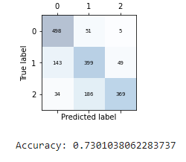
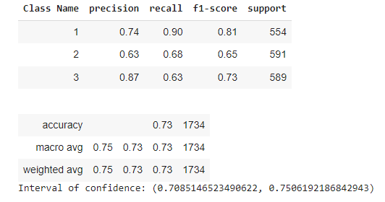
Evaluation Criteria

Slide 11
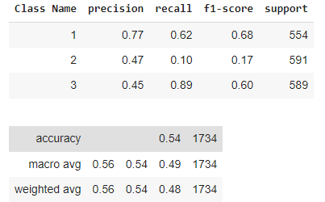
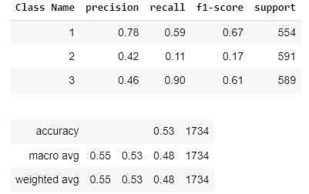
Naive Bayes
Balanced Dataset
Without mean encoding
With mean encoding

Slide 12
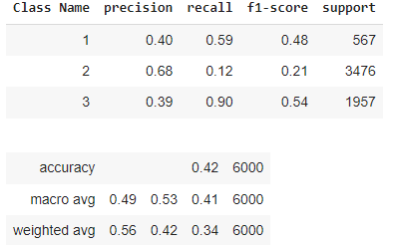
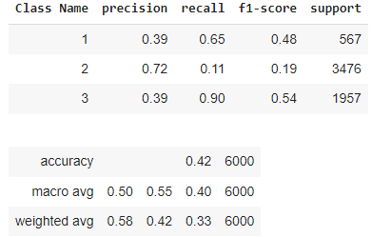
Naive Bayes
Unbalanced Dataset
Without mean encoding
With mean encoding

Slide 13
k-nearest neighbors
Choosing the best dataset and best scaling method.
Mean Encoding → Balanced ↓ | Yes | No
Yes | Standard Acc: 0.678 F1: 0.677 Minmax Acc: 0.682 F1: 0.681 | Standard Acc: 0.559 F1: 0.555 Minmax Acc: 0.560 F1: 0.556
No | Standard Acc: 0.690 F1: 0.685 Minmax Acc: 0.699 F1: 0.695 | Standard Acc: 0.605 F1: 0.598 Minmax Acc: 0.611 F1: 0.605

Slide 14
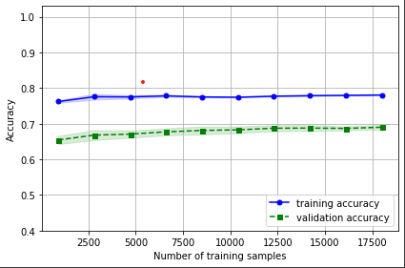
Does the amount of data influence Knn?

Slide 15
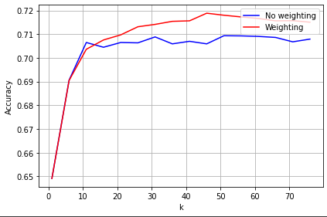
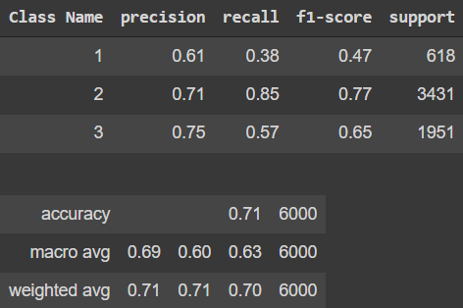
Best parameters for knn

Slide 16
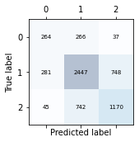
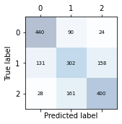
Decision Trees
Balanced | precision
1 | 0.73
2 | 0.55
3 | 0.69
accuracy | 0.66
UnBalanced | precision
1 | 0.45
2 | 0.71
3 | 0.6
accuracy | 0.65

Slide 17
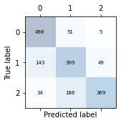
Best Decision tree
Criterion | gini
splitter | best
min_impurity_decrease | 0.0102
min_samples_split | 2
class_weight | {1: 2, 2: 2, 3: 1}
Best DT | precision
1 | 0.74
2 | 0.63
3 | 0.87
accuracy | 0.73

Slide 18
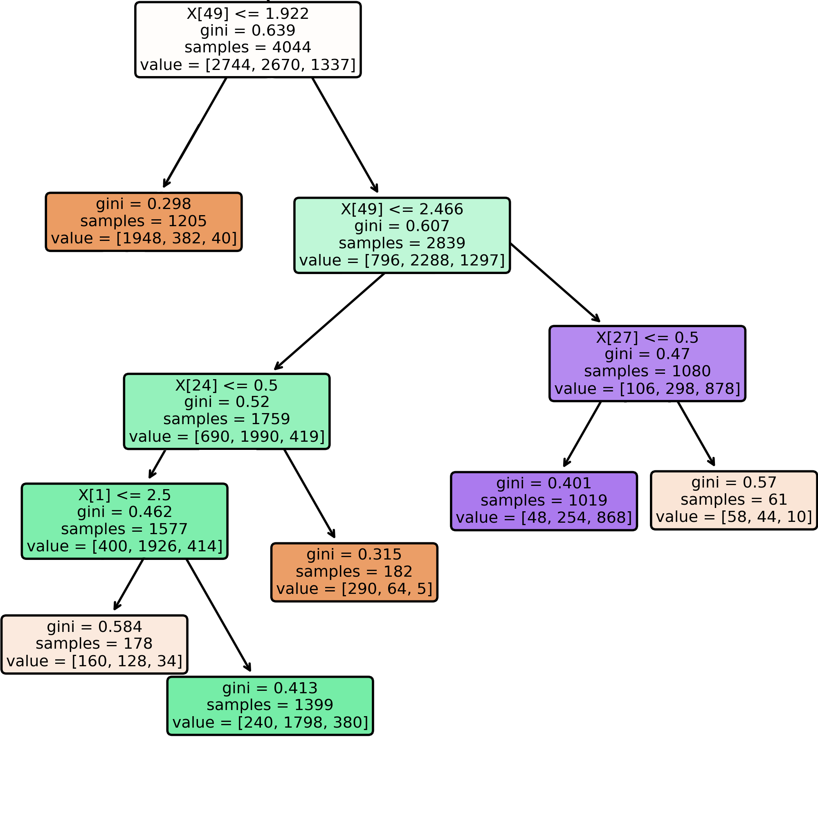
Decision tree

Slide 19
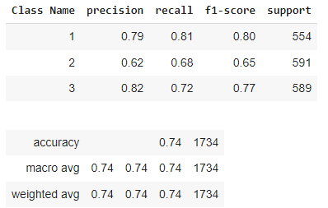
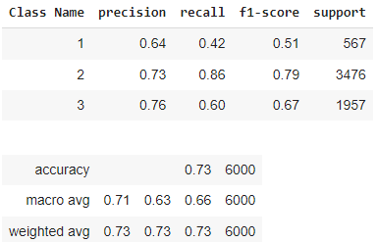
SVM Linear Kernel
Balanced Dataset
Unbalanced Dataset

Slide 20
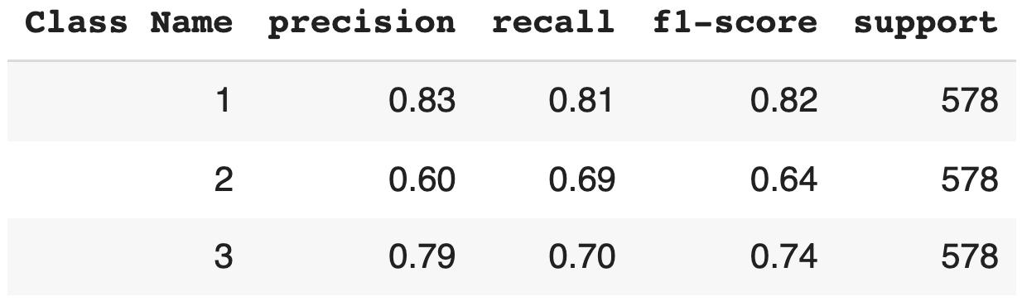
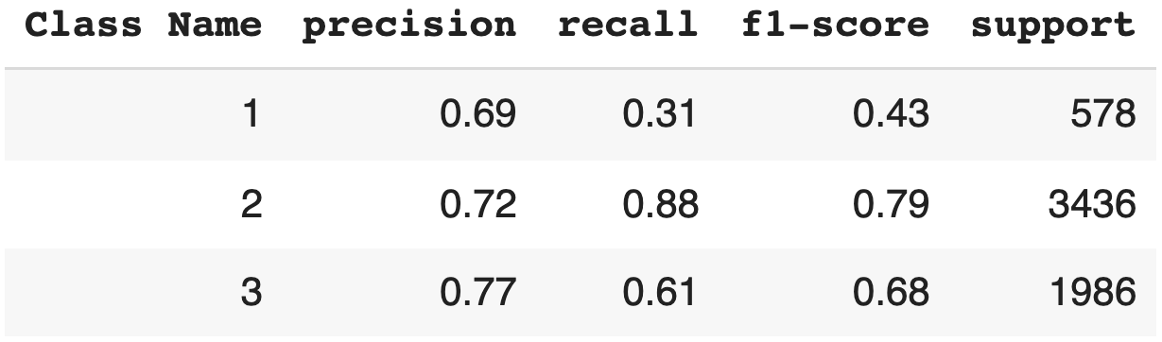
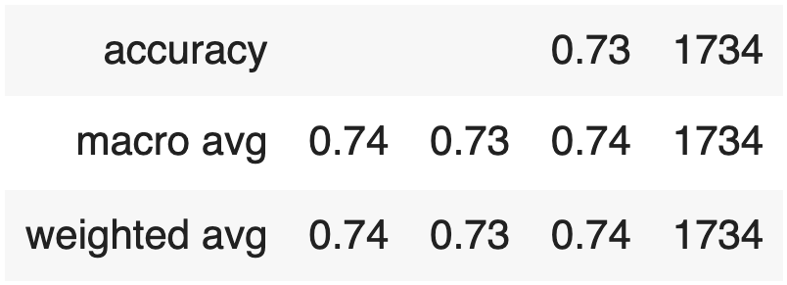
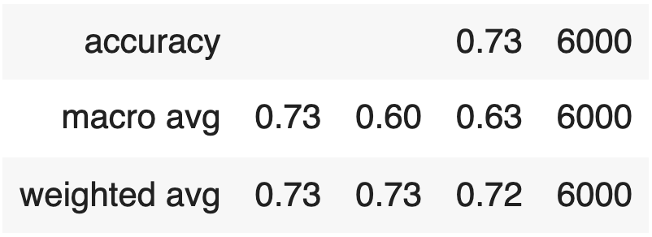
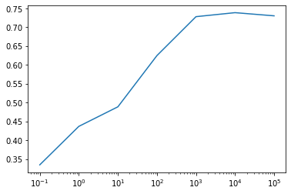
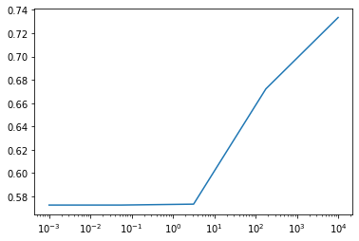
SVM Polynomial Kernel
Balanced dataset
Unbalanced dataset

Slide 21
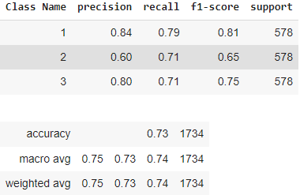
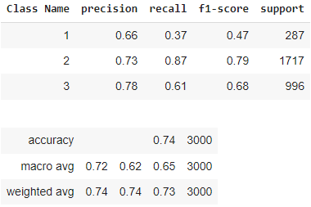
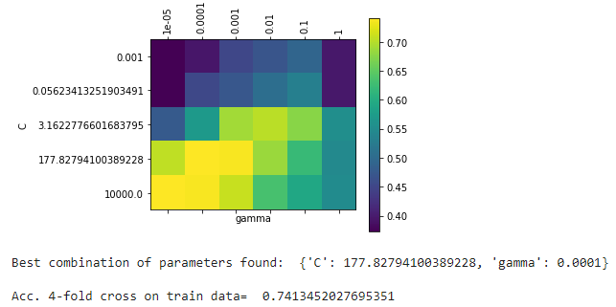
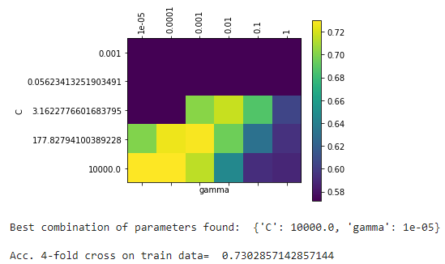
SVM RBF Kernel
Balanced Dataset
Unbalanced Dataset

Slide 22
Meta-learning algorithms
Voting Scheme
Bagging
Random Forest
Boosting

Slide 23
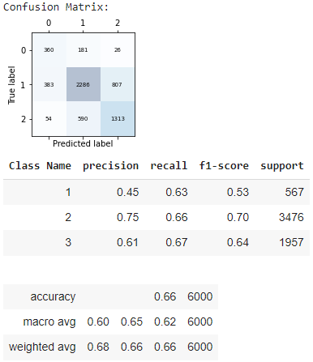
Voting Scheme (Majority voting)
Naive Bayes
KNN
Decision Tree

Slide 24
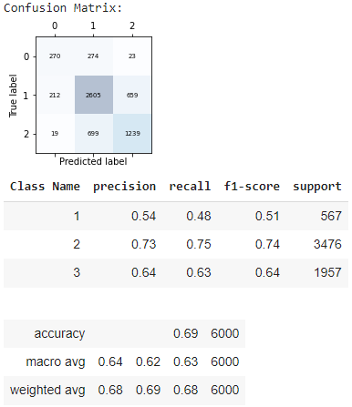
Voting Scheme (Weighted voting)
Naive Bayes
KNN
Decision Tree

Slide 25
Bagging
Naive Bayes
KNN
Decision Tree

Slide 26
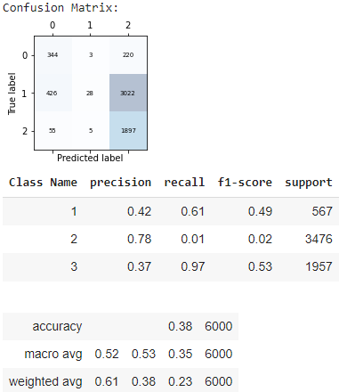
Bagging (Naive Bayes)

Slide 27
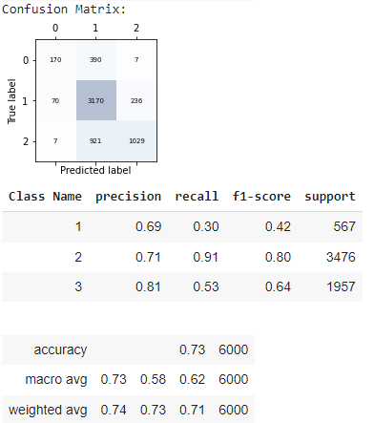
Bagging (KNN)

Slide 28
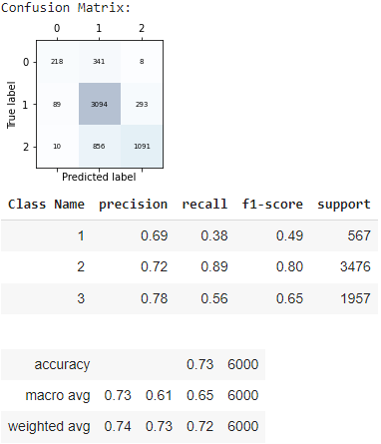
Bagging (Decision Tree)

Slide 29
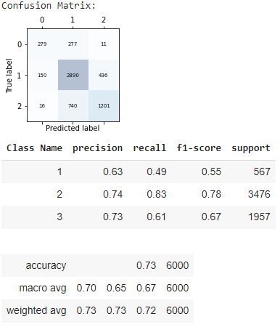
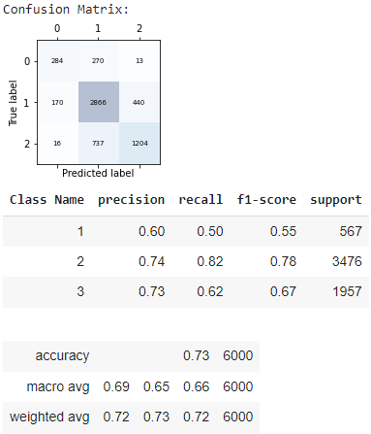
Random Forest
n_estimators = 100
max_features = 0.35
n_estimators = 100

Slide 30
Boosting
Ada Boost Classifier
Gradient Boosting Classifier

Slide 31
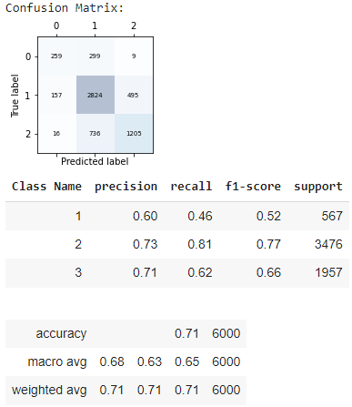
Ada Boost Classifier

Slide 32
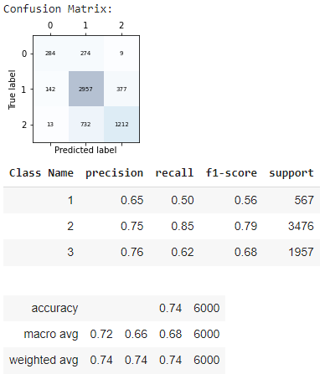
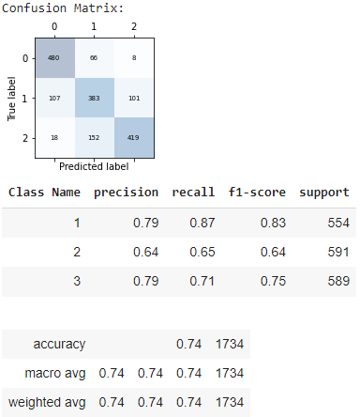
Gradient Boosting Classifier
Balanced

Slide 33
Conclusions
Preprocessing Step
Naive Bayes
Other Methods
Gradient Boosting Classifier
Balanced/Unbalanced

